Slide 1

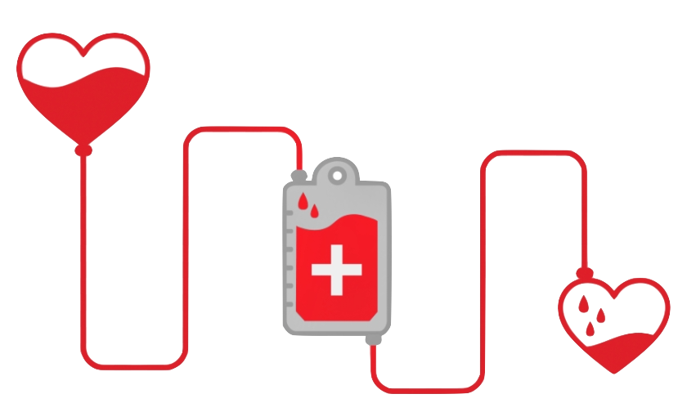

Blood Donation Shortage Prediction
Thip Rattanavilay,
DSC 630 – Predictive Analytics
Bellevue University
Notes:
Blood donation has always been a huge problem globally
Here's how we can use data to predict Blood donation

Slide 2

INTRODUCTION
Most of us have donated blood at least once in our lifetime or has not.
Blood Banks faces supply and demand and shortage
We want to know often do the donors return to donate blood.
There are variety of factors that can impact a blood donation.
This project uses a dataset with various features to solve this problem
We want to find how many donations are being made and attempt to predict blood donations.
This gathering will be useful in targeting the people who are interested in donating blood, which results in getting more volunteers to save more lives.

Slide 3
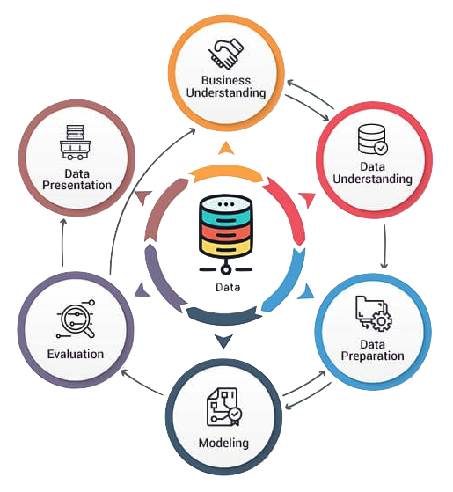
METHOD & STEPS
CRISP-DM
Understanding the business
Data understanding
Exploratory analysis of the dataset
Data cleaning and preparation
Split the data set into train and test set
Training and Test the models
Feature selection
Model evaluation
Results

Slide 4
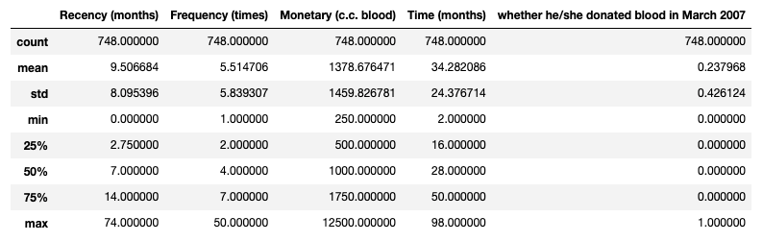
DATA UNDERSTANDING & EXPLORATORY DATA ANALYSIS
Transfusion dataset #1
This data frame has 748 rows and 5 variables.
Key variables are
Recency months
Frequency times
Monetary c.c blood
Time months
Whether he/she Donated blood in March 2007

Slide 5
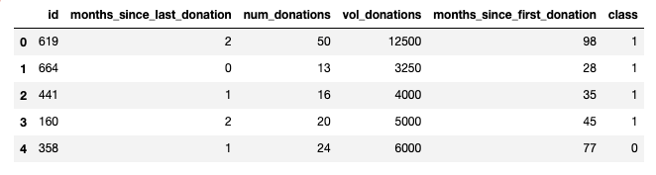
DATA UNDERSTANDING & EXPLORATORY DATA ANALYSIS
Transfusion dataset #2
This data frame has 576 rows and 5 variables.
Key variables are
id
Months since last donation
Num donations
Vol donations
Months since first donation
Class

Slide 6
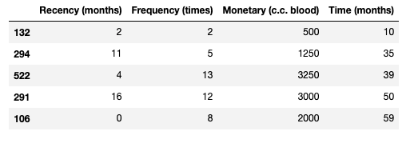
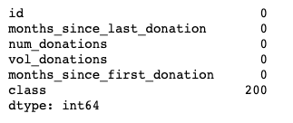
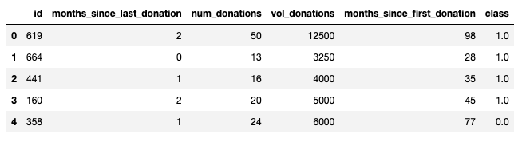
Features and Joined datasets
Joining these features as one dataset
Months since Last Donation
Number of Donations
Total Volume Donated
Months since First Donation
Recency
Frequency
Time
Monetary
Training and test dataset

Slide 7
DATA UNDERSTANDING & EXPLORATORY DATA ANALYSIS
In the class column there are two classes
class 1 : The donor donated blood in March 2007.
class 0 : The donor did not donate blood in March 2007.
Let us assume that class 1 means donated, and class 0 means not donated

Slide 8


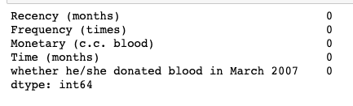

DATA PREPARATION & CLEANING
Inspecting transfusion dataset
Checked the data frame for null, or missing value
No missing values, and we have 576 rows and 6 Columns with clean data.
The features are 'Months since Last Donation', 'Number of Donations', 'Total Volume Donated', 'Months since First Donation'.

Slide 9
TRAINING & TEST MODELING
Training is the process of applying the available data to the chosen algorithms
For the project I will be using 5 prediction models
I will also find Correlation between Features
Training multiple models allow comparing and choosing the best performing model.
Using 5 models in total with cross-validation

Slide 10
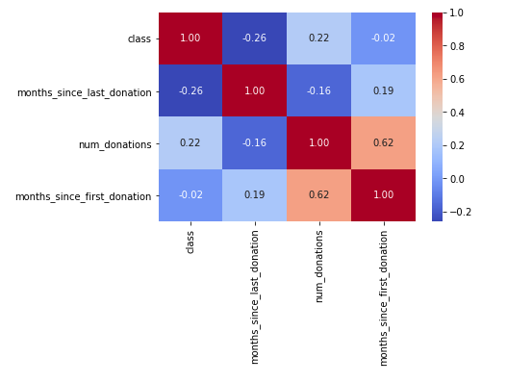
FEATURE SLECTION
Correlation matrix between numerical values.
Only months_since_first_donation seems to have a significative correlation with the class probability.
It doesn't mean that the other features are not useful. num_donations in these features can be correlated with the class.

Slide 11
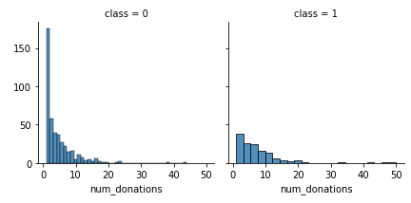
FEATURE SLECTION
We notice that num_donations distributions are not the same in the class 1 and class 0 subpopulations.
Indeed, there is a peak corresponding to the people who have donated. We can see that class 0 has a higher number than class 1. There will be no donation class 0 and fewer donation for class 1.

Slide 12
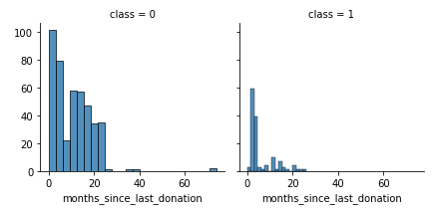
FEATURE SLECTION
We notice that months_since_last_donation distributions are not the same in the class 1 and class 0 subpopulations.
Indeed, there is a peak corresponding to the people who have donated recently (in 1-2 months) will donate blood.
It seems that people have donated recently are more likely to donate blood.

Slide 13
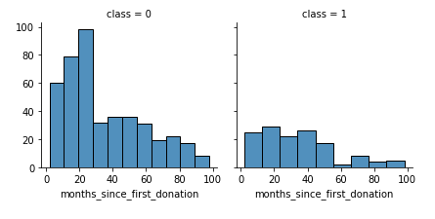
FEATURE SLECTION
We notice that months_since_first_donation distributions are not the same in the class 1 and class 0 subpopulations.
Indeed, there is a peak corresponding to the people who have just donated recently (in 6-20 months) will not donate blood.

Slide 14
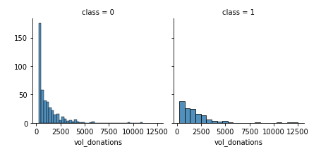
FEATURE SLECTION
Volume donated is also a good feature to know whether the donor will donate or not.

Slide 15
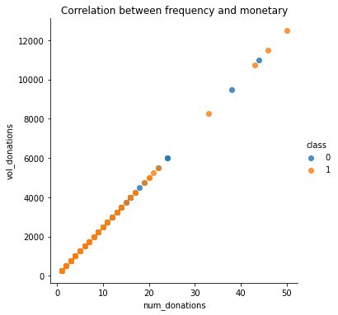
Correlation between frequency and monetary
From the graph we can see that Frequency and monetary values are highly correlated. So, we can use only the frequency

Slide 16


Modeling Cross Validation Models I will compare five (5) popular classifiers and I will evaluate them using the mean accuracy of each of them using the kfold cross validation procedure. - Decision Tree - Random Forest - Gradient Boosting - KNN - Logistic regression

Slide 17
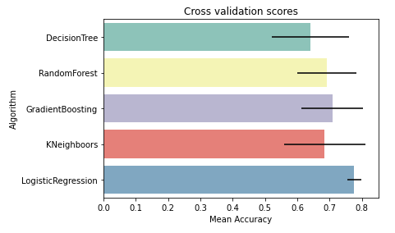
Modeling
Cross Validation Models
I compared five (5) popular classifiers and evaluate the mean accuracy of each of them by a stratified kfold cross validation procedure.
By seeing the figure, we can see that what model will work the best.

Slide 18
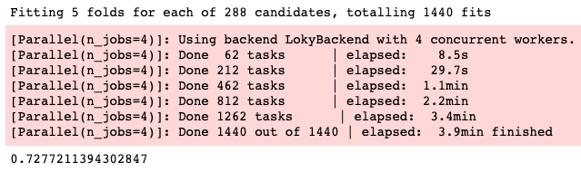
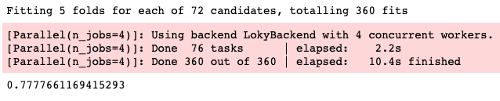
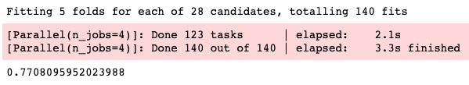
Modeling
Random Forest
Hyperparameter tunning for best models
I performed a grid search optimization for Random Forest, Gradient Boosting classifiers and Logistic Regression.
The computation time is clearly reduced.
Gradient Boosting
Logistic Regression

Slide 19
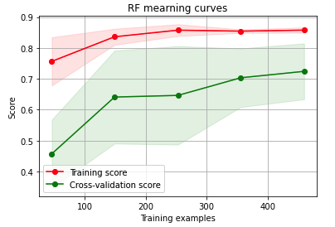
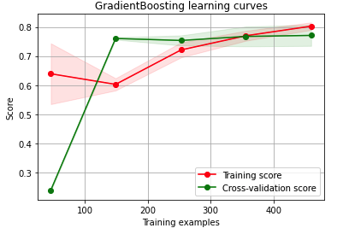
Modeling
Random Forest
Plot learning curve
I performed a learning curve for Random Forest, and Gradient Boosting classifiers.
Gradient Boosting
According to the cross-validation curves Random Forest classifier seems to be the better prediction model. Because the training and cross-validation curves are close together.

Slide 20
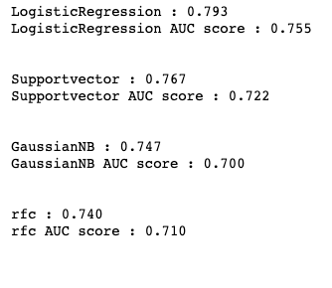
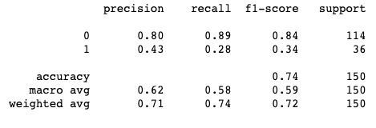
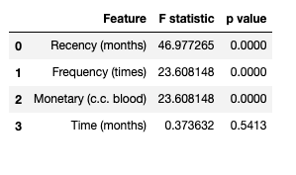
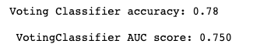
RESULTS

Slide 21
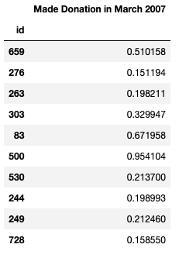
Now we can target the people (id) who are interested in donating blood, and which will result in getting more volunteers and we can save more lives.
RESULTS PREDICTION

Slide 22
Thank you!
In results with prediction, we measured accuracy on donations donated each months
We have achieved nearly 78% accuracy and hoping to get a better result from more cross-validation and methods
Donors are more likely to donate and become a repeat donor
COME AND DONATE TODAY

Slide 23
REFENCES
https://www.proglobalbusinesssolutions.com/six-steps-in-crisp-dm-the-standard-data-mining-process/
https://www.usatoday.com/story/news/health/2021/06/23/blood-banks-urge-donations-us-blood-supply-drops-demand-increases/5312985001/
https://machinelearningmastery.com/tpot-for-automated-machine-learning-in-python/
https://rdrr.io/cran/simpleNeural/man/UCI.transfusion.html

